Slide 1

Blazor

Slide 2




Who is Jerry?
Active in IT since 2006
Technical Consultant .NET Solutions @ Inetum-Realdolmen
Technical Lead DevOps-Team Zanzibar
Definitly a back-end person
jerry.vanechelpoel@inetum-realdolmen.world
@qlurichaun
www.linkedin.com/in/jerryvanechelpoel

Slide 3
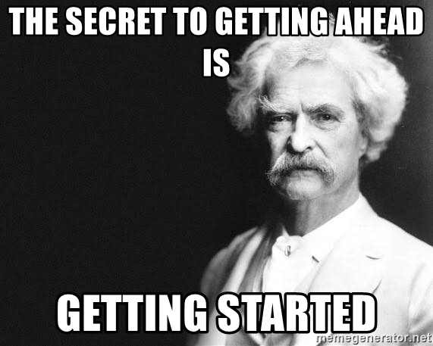
Intentions

Slide 4
What are you going to learn today?
01
05
Introduction to Blazor
Navigation
02
06
Blazor projects
Validation
03
07
Components
Deploying to Azure
04
Binding & events

Slide 5
Introduction to Blazor
01

Slide 6
What is Blazor?
Framework for building interactive web client UI with .NET
Combines
HTML
CSS
C#
Does not require JavaScript
But you can still use it

Slide 7
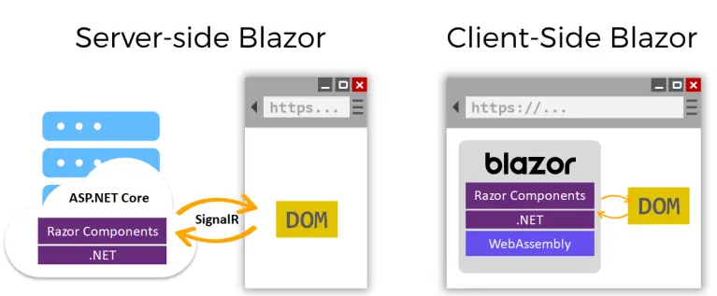
Flavours

Slide 8
Server-Side Blazor
Application logic is executed on the server
SignalR is used to communicate changes between server and client
Advantages
Smaller initial download
Full .NET functionality
No limitations caused by the browser and the client
Disadvantages
Lower response time
More load on the server
Application must be online

Slide 9
Client-Side Blazor - WebASseMbly (WASM)
“.NET in the browser”
Blazor application is downloaded into the browser
Assets such as CSS and images are downloaded when needed
Advantages
Application can run “offline” (external dependencies excluded)
Higher response time
Less load on the server
Disadvantages
Initial download takes longer → full application ⬄ single page
Browser and the client could limit the possibilities of the application → technical, security
Harder to debug → Chrome of Edge

Slide 10

WASM
Open standard
Portable binary-code format for executable programs
Supported by most browsers
WASM vs. JavaScript
Filesize: 10 to 20 % smaller
Execution speed: around 10 times faster (reduced parsing, practicly native)
https://webassembly.org/

Slide 11
Blazor projects
02

Slide 12
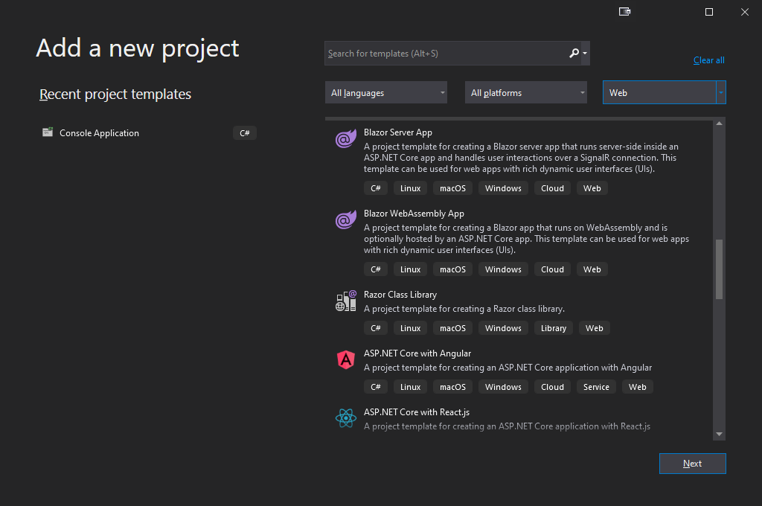
Creating a Blazor project (1)

Slide 13
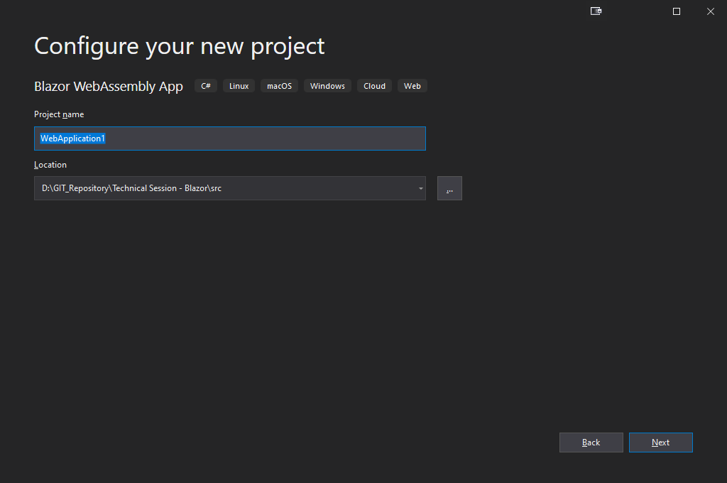
Creating a Blazor project (2)

Slide 14
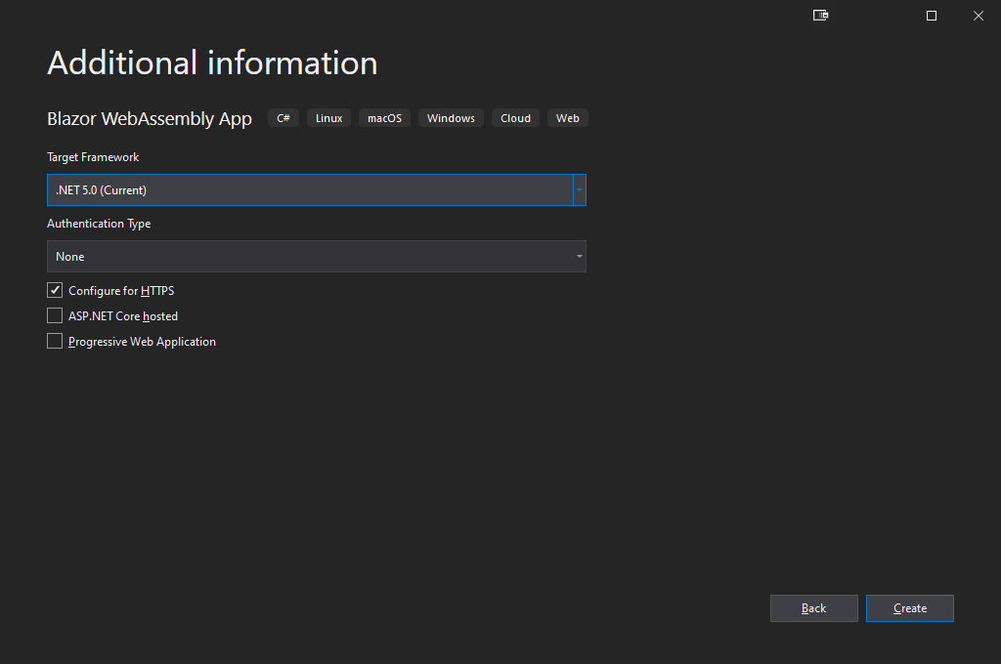
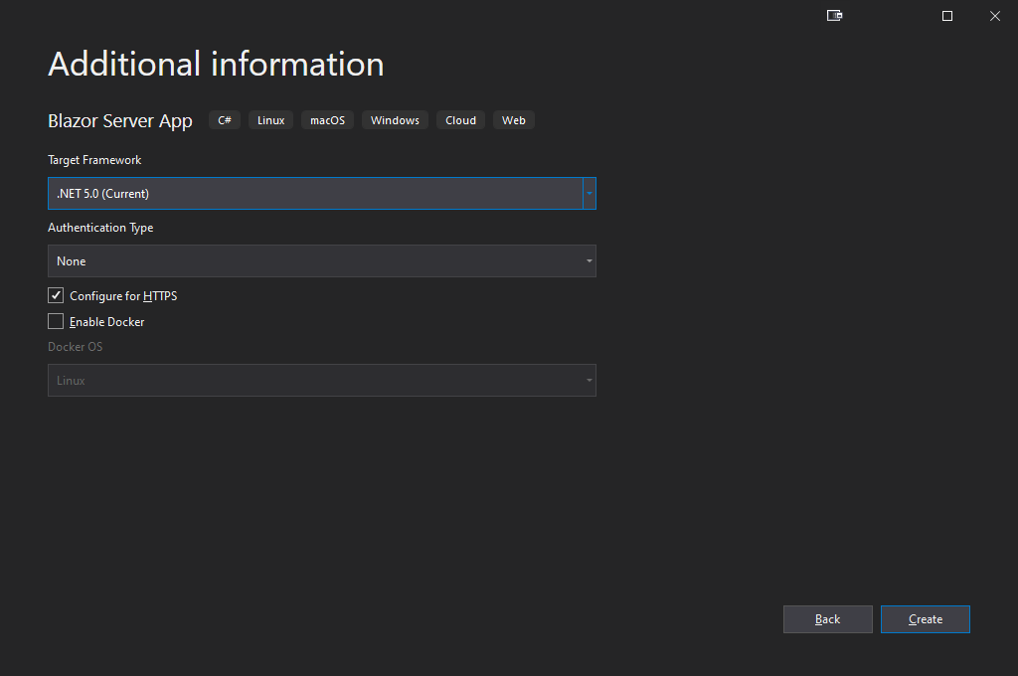
Creating a Blazor project (3)

Slide 15
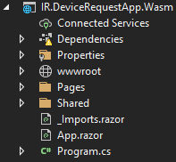
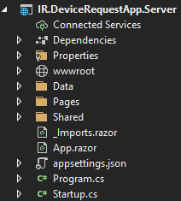
Blazor project structure

Slide 16
Configuring a Blazor app
Server
Program.cs
Configure ASP.NET Core host
Startup.cs
ConfigureServices() → Configure dependency injection
Configure() → request handling pipeline
MapBlazorHub() → Set up real-time connection between browser and server through SignalR
MapFallbackToPage("/_Host") → Configure root page of the app (Pages/_Host.cshtml) and enable navigation
WASM
Program
Configure WASM host
Configure dependency injection
Through builder.Services

Slide 17

Static content
wwwroot
All public accessible, static content
Content
index.html (only in client-side Blazor)
Css
Images
Scripts
favicon.ico

Slide 18
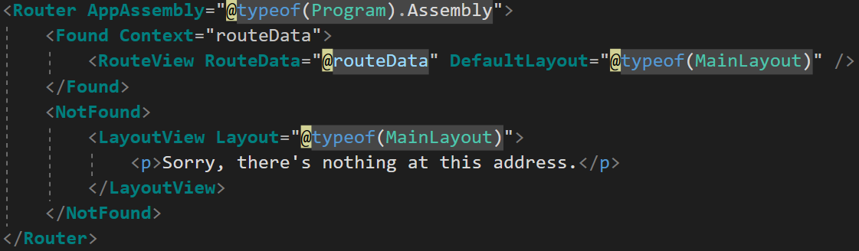
Starting a Blazor app
app.razor
Root component of the app
Contains a Router-tag
Found → used for known routes, renders the requested page
NotFound → used for unknown routes

Slide 19
Application Settings
Server
Regular ASP.NET configuration
appsettings.json → in the root of the project
WASM
Not present by default
appsettings.json → should be added in wwwroot
Settings are downloaded to client
!!! All settings are visible !!!

Slide 20
Dynamic content
Pages folder
Contains all navigable, dynamic pages and components used by the app
Razor pages
_Host.cshtml: root page of a server-side Blazor app (Blazor Server only)
Error.cshtml: error page shown when an uncaught exception is encountered (Blazor Server only)
Shared folder
Contains all UI components used by the navigable pages and components within the app
Razor pages
MainLayout.razor
NavMenu.razor

Slide 21
Layout
MainLayout.razor
Default generated
Used by default on every page when defined in DefaultLayout-attribute in RouteView
Default layout can be overriden by using the @layout directive
Custom layout
Always inherits from LayoutComponentBase: @inherits LayoutComponentBase
Use @layout directive on page

Slide 22
_Imports.razor
Contains commands to be executed on pages within the folder and its subfolders
Using statements
Custom layout
Can be added for every subfolder in the app

Slide 23
Components
03

Slide 24
What are Blazor components?
Every UI element
Page
Layout
Dialog
Data entry form
…
Defined in a file with .razor extension
Code can be defined in
the .razor file of the component
within a .cs file

Slide 25
Parts of a .razor file
@page "/componentlocation"
Required when navigation is needed
Always starts with a forward slash
@inject typename propertyname
Used when a service needs to be injected
@using namespace
Specific namespace required in the component
@attribute [attributename]
Attributes to apply on the component
Markup
The HTML-layout of the component
@code { // C# code }
The C#-code executed within the page

Slide 26
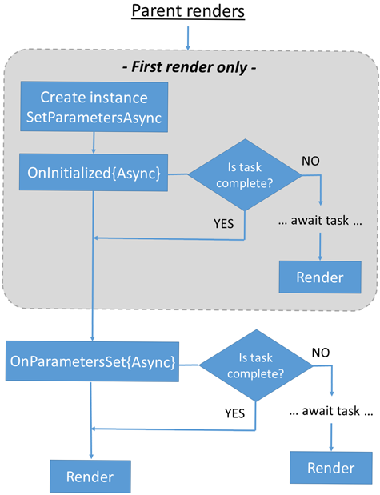
Razor component lifecycle
ASP.NET Core Razor component lifecycle

Slide 27
Seperating code and layout
Code can be put into a .cs file
Create partial class in the same namespace as the page
cs-file can be in a different folder as the razor-file

Slide 28
Custom Components
Reusable components
Configurable properties and events
[Parameter]-attribute
Component properties
Custom events → Properties with type of EventCallback or EventCallback<T>
No @page-directive
Component can be used in other components by defining a tag with the components name

Slide 29
Layout frameworks
Free license
MatBlazor
Material.Blazor
Radzen
MudBlazor
Blazored
Blazorise
Paid license
SyncFusion
Telerik
DevExpress
! Be careful !
Libraries have a focus on either JavaScript or WASM!

Slide 30
Binding & events
04

Slide 31
Binding
Coupling of data and events to components and elements
Properties and Events
Requires a [Parameter]-attribute
One-way
From C#-code to UI
Through @-notatie
Ex: <h3>@Title</h3>
Two-way
From C#-code to UI and back
Through @bind
Ex: <input type="text" @bind="Name" />

Slide 32
Capturing changes & events
Changes are by default captured through the html-event onchange
Capturing other events is also possible
@bind-value: captures the onchange event on the value and binds it on a property
@bind-value:event: binds a specific event
Example: <input type="text" @bind-value="Name" @bind-value:event="oninput" />

Slide 33
Handling events
React to HTML-events
onclick
oninput
onselect
…
Define an event handler
Attribute in HTML-tag
Handle events in JavaScript → <button onclick=“MyJavaScriptFunction" />
Handle events in C# → <button @onclick=“MyCsharpFunction" />

Slide 34
Creating an event handler
C#-method
Can be async
EventArgs
Parameter contains information about the event
List of EventArgs
No other parameters possible

Slide 35
Navigation
05

Slide 36
Routing

Slide 37
Setting up a route
@page directive in the razor file
Multiple page directives are possible
Making a component available on multiple routes
Vb: @page "/counter" @page "/anothercounter"
Parameters
Placeholder in the page directive
Vb: @page "/counter/{startfrom}“
Add property decorated with [Parameter] attribute

Slide 38
Parameter restrictions
String by default
int ➔ {parametername:int}
bool ➔ {parametername:bool}
datetime ➔ {parametername:datetime}
decimal ➔ {parametername:decimal}
double ➔ {parametername:double}
float ➔ {parametername:float}
guid ➔ {parametername:guid}
long ➔ {parametername:long}

Slide 39
NavMenu
Optional component which allows navigation in the app
NavLink
Creates a link like <a href>
Match-attribute: behaviour of the active css on the generated link
NavLinkMatch.All: the whole URL in the href-attribute should match
NavLinkMatch.Prefix: the first part of the URL in the href-attribute should match

Slide 40
NavigationManager
Component that enables programmatic navigation
Microsoft.AspNetCore.Components.NavigationManager
Instance needs to be injected through dependency injection
Properties
Uri
Returns the current uri
BaseUri
Returns the base uri
Events
LocationChanged
Event triggered when the navigation location changes

Slide 41
NavigationManager
Methods
NavigateTo(string uri, bool forceReload = false)
Enables navigation to another component
Uri: path to navigate to
forceReload: when true, reloads the page from the server
ToAbsoluteUri(string relativeUri)
Converts a relative URI to an absolute URI
ToBaseRelativePath(string relativeUri)
Converts an absolute URI to a relative based on the prefix defined in the BaseUrl property

Slide 42
Validation
06

Slide 43
Validation parts
Create a model
Set the EditContext
Handle OnValidSubmit event
Define an EditForm component
Add a Validator
Add ValidationSummary or ValidationMessage components

Slide 44
1. Create a model
POCO Class with properties
Properties attributed with DataAnnotations

Slide 45
The EditContext
Holds metadata of the editing process
Fields that have been modified
Set of validation messages
Setting the EditContext
Through Model property (preferred)
EditContext is created as cascading value
Through EditContext property
Manual

Slide 46
2. Set the EditContext – Model property
Add a property and bind it through the Model attribute of the EditForm
Property is added in code
Set property in OnInitialized()
Component will not execute when Model or EditContext is empty

Slide 47
3. Handle OnValidSubmit event
Define method that is executed when the validation is succesful

Slide 48
4. Define an EditForm component
EditForm tag
Model-attribute
OnValidSubmit-attribute
Validator-tag
Input fields

Slide 49
Input fields
Components to input data
InputText → TextBox
InputTextArea → TextArea
InputSelect → Dropdownlist
InputNumber → NumberPicker
InputCheckbox → Checkbox
InputDate → DatePicker

Slide 50
5. Add a validator
Component that stores the validation messages in a ValidationMessageStore
DataAnnotationsValidator
Built-in validator based on System.ComponentModel.DataAnnotations
Suffices in most cases
Custom Validator
Makes it possible to create your own validator

Slide 51
6. Add ValidationSummary or ValidationMessage components
Show validation messages from EditContext
ValidationSummary
Shows all validation messages as a list
Ex: <ValidationSummary />
ValidationMessage
Shows validation messages of a specific property
Ex: <ValidationMessage For="@(() => Subscription.LastName)" />

Slide 52
Deploying to Azure
07

Slide 53
Deploying Server-side Blazor
Web App Service
Like any other ASP.NET Server-side application
Azure DevOps Release pipelines
Publish through Visual Studio

Slide 54
Deploying Client-side Blazor
Web App Service
Static website in a Storage Account
Like a single page application
Azure CLI
Clean app: az storage blob delete-batch --source $web --account-name <storageaccountname> --auth-mode login
Deploy app az storage blob upload-batch --account-name <storageaccountname> --destination $web --source ./ --auth-mode login (escape the $ with ` if an exception is thrown)

Slide 55


